Slide 1
SKN Sinhgad Institute of Technology & Science, Lonavala
Project Title
E-Setu
Lalit H. Suthar
Guide: Prof. Jayshree mahajan

Slide 2
Content
Introduction
Objective
SRS(H/W & S/W requirements)
Detail description
Features
E-R dig.
Results(Description + Screenshots)
Conclusion
References

Slide 3
Introduction
The purpose of the Project is to make the entire process transparent so that any layman can easily follow the step-by-step instructions to get the desired certificate hassle-free and on time. SETU ensures the process is convenient, faster and fully beneficial to the common man. The SETU website is an initiative by this Collectorate to be more responsive to the people's need using today's Information Technology (IT). SETU has built the bridge. Use it. And help us to help you better. The motto of SETU says it perfectly - 'Sevetun Samadhaan' which means Satisfaction through Service.

Slide 4
Objectives
The interface should provide the user with all the regular Facilities of Government.
The Interface should provide the user his certificate i.e. Caste ,Domicile . Income ,Senior citizen ID card, etc.
The Problem of the users should be appropriately addressed by providing Government services through Internet.
Save Time of user and Create a fully Transparency Government System.

Slide 5
Requirements
Software Requirements:
Windows (32bit & 64bit)
Apache Tomcat 6.0 or above
Web Browser
XAMP
Diagram Designer
Hardware Requirements:
50 MB HDD Free Space (200 MB free space Recommended)
256 MB RAM (1GB or more Recommended)
Pentium IV Processor (or above)

Slide 6
Types Of Services
Caste Certificate.
Income Certificate
Domicile Certificate.
Senior Citizen ID card.
Online Validity Checking Of issued Document.

Slide 7
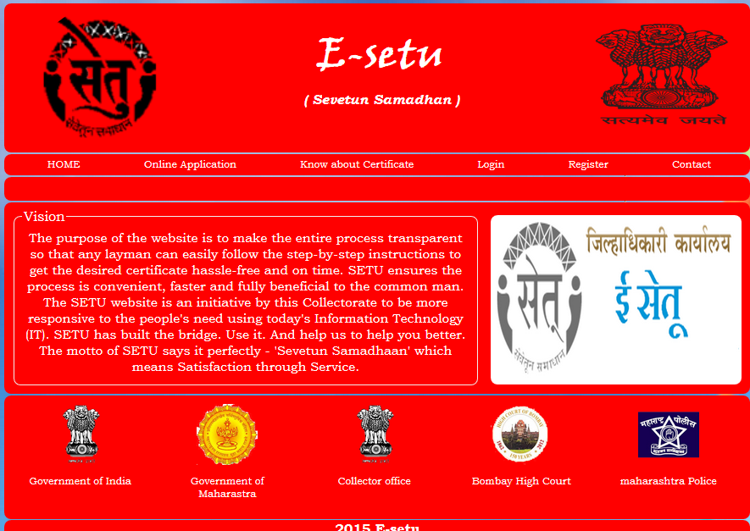

Slide 8
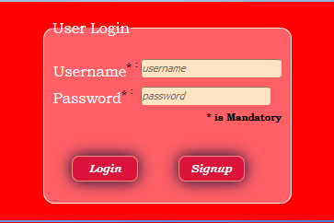
Login Page

Slide 9
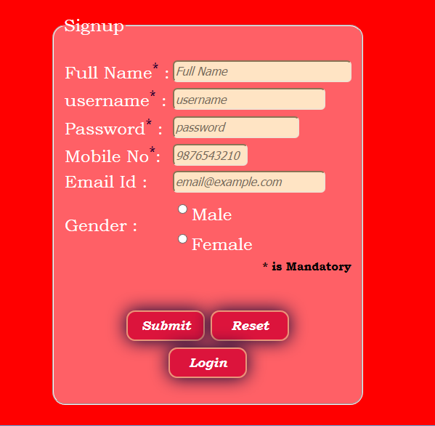
SignUp Form

Slide 10
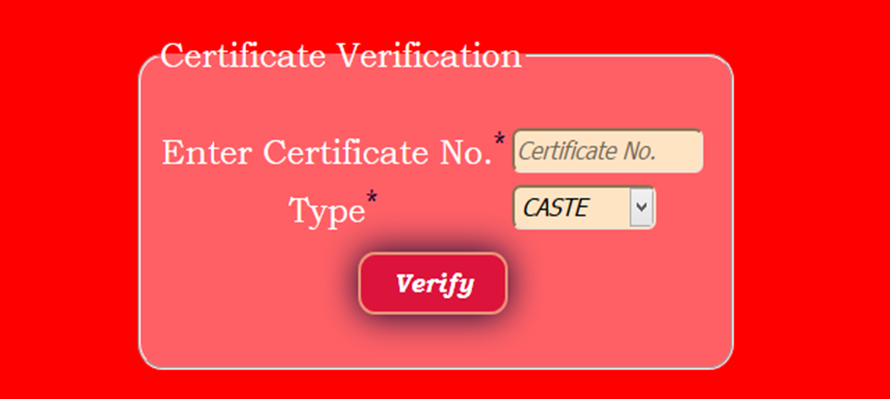
Verification

Slide 11
FEATURES

Slide 12
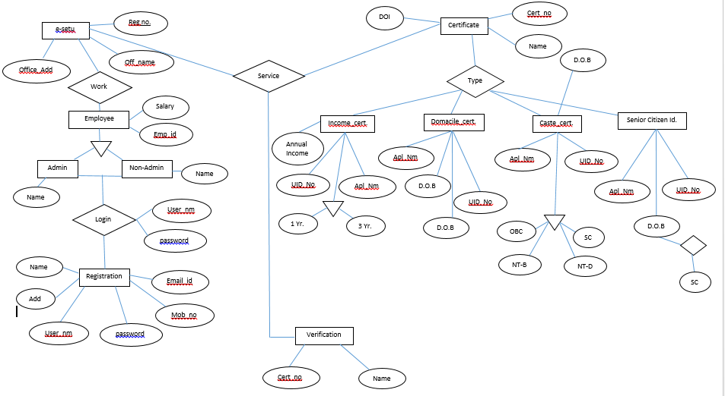
E-R Diagram

Slide 13
Result

Slide 14
Conclusion
“E-Setu ( E-Sovernance System ) ” is software has the perspective of attaining attraction of those scheme/policy which don’t have one good performing software for keeping their information secure and make their management easier.

Slide 15
References
www.php.net
www.mongodb.com
www.w3school.com
www.stackoverflow.com

